Slide 1
14
Files and Streams

Slide 2
I can only assume that a “Do Not File” document is filed in a “Do Not File” file.
  Senator Frank Church
  Senate Intelligence Subcommittee Hearing, 1975
Consciousness does not appear to itself chopped up in bits. A “river” or a “stream” are the metaphors by which it is most naturally described.
  William James
I read part of it all the way through.
  Samuel Goldwyn
A great memory does not make a philosopher, any more than a dictionary can be called grammar.
  John Henry, Cardinal Newman

Slide 3
OBJECTIVES
In this chapter you will learn:
To create, read, write and update files.
To use class File to retrieve information about files and directories.
The Java input/output stream class hierarchy.
The differences between text files and binary files.
Sequential-access and random-access file processing.
To use classes Scanner and Formatter to process text files.
To use the FileInputStream and FileOutputStream classes.
To use a JFileChooser dialog.
To use the ObjectInputStream and ObjectOutputStream classes.
To use class RandomAccessFile.

Slide 4
14.1 Introduction
14.2 Data Hierarchy
14.3 Files and Streams
14.4 Class File
14.5 Sequential-Access Text Files
14.5.1 Creating a Sequential-Access Text File
14.5.2 Reading Data from a Sequential-Access Text File
14.5.3 Case Study: A Credit-Inquiry Program
14.5.4 Updating Sequential-Access Files

Slide 5
14.6 Object Serialization
14.6.1 Creating a Sequential-Access File Using Object Serialization
14.6.2 Reading and Deserializing Data from a Sequential- Access File
14.7 Random-Access Files
14.7.1 Creating a Random-Access File
14.7.2 Writing Data Randomly to a Random-Access File
14.7.3 Reading Data Sequentially from a Random-Access File
14.7.4 Case Study: A Transaction-Processing Program
14.8 Additional java.io Classes
14.9 Opening Files with JFileChooser
14.10 Wrap-Up

Slide 6
14.1 Introduction
Storage of data in variables and arrays is temporary
Files used for long-term retention(ধারণ) of large amounts of data, even after the programs that created the data terminate
Persistent data – exists beyond the duration of program execution
Files stored on secondary storage devices
Stream – ordered data that is read from or written to a file

Slide 7
14.2 Data Hierarchy
Computers process all data items as combinations of zeros and ones
Bit – smallest data item on a computer, can have values 0 or 1
Byte – 8 bits
Characters – larger data item
  Consists of decimal digits, letters and special symbols
  Character set – set of all characters used to write programs and represent data items
    Unicode – characters composed of two bytes
    ASCII

Slide 8
14.2 Data Hierarchy
Fields – a group of characters or bytes that conveys meaning
Record – a group of related fields
File – a group of related records
Data items processed by computers form a data hierarchy that becomes larger and more complex from bits to files
Record key – identifies a record as belonging to a particular person or entity – used for easy retrieval of specific records
Sequential file – file in which records are stored in order by the record-key field
Database – a group of related files
Database Management System – a collection of programs designed to create and manage databases

Slide 9
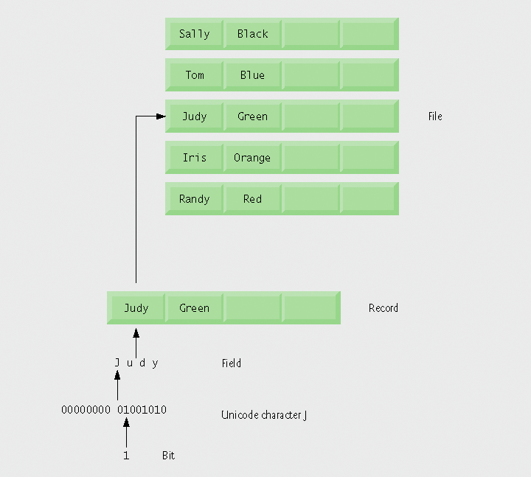
Fig. 14.1 | Data hierarchy.

Slide 10
14.3 Files and Streams
Java views each files as a sequential stream of bytes
Operating system provides mechanism to determine end of file
  End-of-file marker
  Count of total bytes in file
  Java program processing a stream of bytes receives an indication from the operating system when program reaches end of stream

Slide 11
14.3 Files and Streams
File streams
  Byte-based streams – stores data in binary format
    Binary files – created from byte-based streams, read by a program that converts data to human-readable format
  Character-based streams – stores data as a sequence of characters
    Text files – created from character-based streams, can be read by text editors
Java opens file by creating an object and associating a stream with it
Standard streams – each stream can be redirected
  System.in – standard input stream object, can be redirected with method setIn
  System.out – standard output stream object, can be redirected with method setOut
  System.err – standard error stream object, can be redirected with method setErr

Slide 12
14.3 Files and Streams
java.io classes
  FileInputStream and FileOutputStream – byte-based I/O
  FileReader and FileWriter – character-based I/O
  ObjectInputStream and ObjectOutputStream – used for input and output of objects or variables of primitive data types
  File – useful for obtaining information about files and directories
Classes Scanner and Formatter
  Scanner – can be used to easily read data from a file
  Formatter – can be used to easily write data to a file

Slide 13

Fig. 14.2 | Java’s view of a file of n bytes.

Slide 14
14.4 Class File
Class File useful for retrieving information about files and directories from disk
Objects of class File do not open files or provide any file-processing capabilities

Slide 15
Creating File Objects
Class File provides four constructors:
  Takes String specifying name and path (location of file on disk)
  Takes two Strings, first specifying path and second specifying name of file
  Takes File object specifying path and String specifying name of file
  Takes URI object specifying name and location of file
Different kinds of paths
  Absolute path – contains all directories, starting with the root directory, that lead to a specific file or directory
  Relative path – normally starts from the directory in which the application began executing

Slide 16
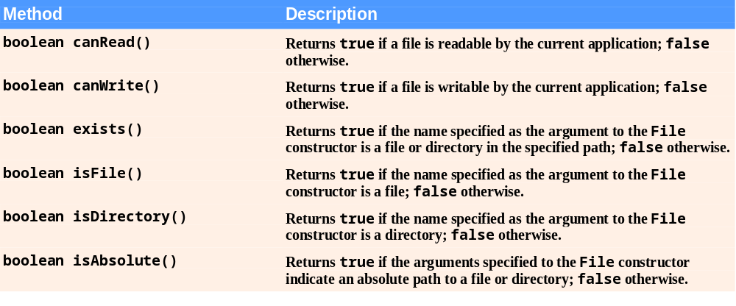
Fig. 14.3 | File methods.
(Part 1 of 2)

Slide 17
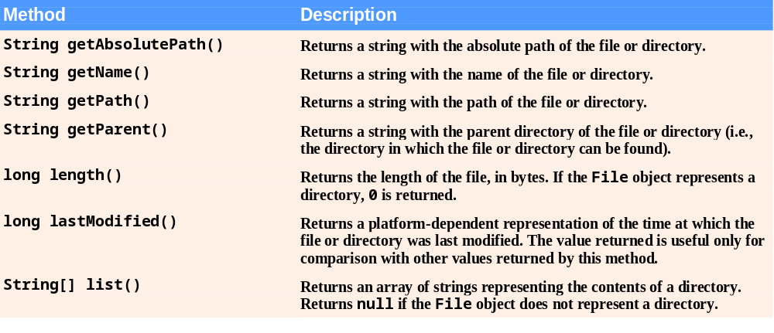
Fig.14.3 | File methods.
(Part 2 of 2)

Slide 18
Error-Prevention Tip 14.1
Use File method isFile to determine whether a File object represents a file (not a directory) before attempting to open the file.

Slide 19
Demonstrating Class File
Common File methods
  exists – return true if file exists where it is specified
  isFile – returns true if File is a file, not a directory
  isDirectory – returns true if File is a directory
  getPath – return file path as a string
  list – retrieve contents of a directory
Separator character – used to separate directories and files in a path
  Windows uses \
  UNIX uses /
  Java process both characters, File.pathSeparator can be used to obtain the local computer’s proper separator character

Slide 20
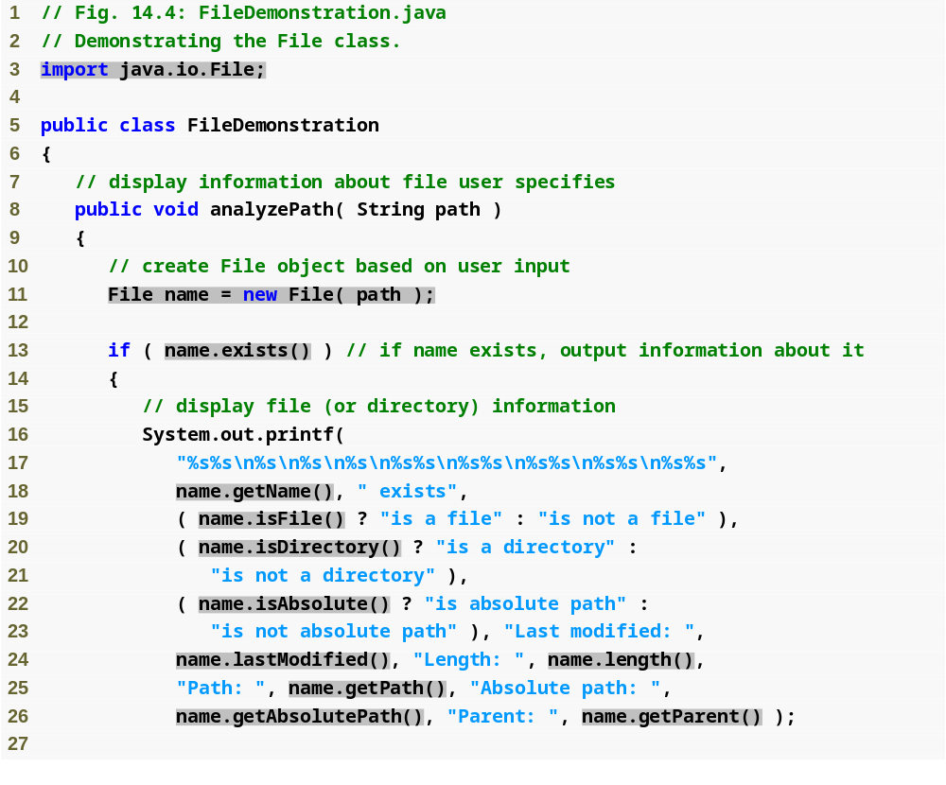
Outline
FileDemonstration
.java
(1 of 2)
Create new File object; user specifies file name and path
Returns true if file or directory specified exists
Retrieve name of file or directory
Returns true if name is a file, not a directory
Returns true if name is a directory, not a file
Returns true if path was an absolute path
Retrieve time file or directory was last modified (system-dependent value)
Retrieve length of file in bytes
Retrieve path entered as a string
Retrieve absolute path of file or directory
Retrieve parent directory (path where File object’s file or directory can be found)

Slide 21
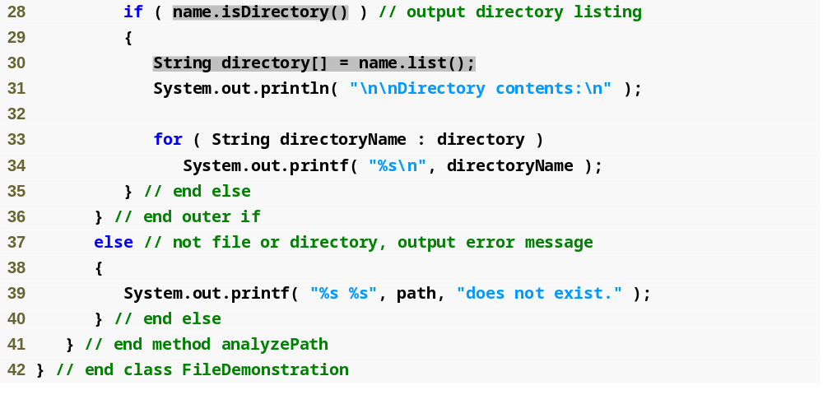
Outline
Returns true if File is a directory, not a file
FileDemonstration
.java
(2 of 2)
Retrieve and display contents of directory

Slide 22
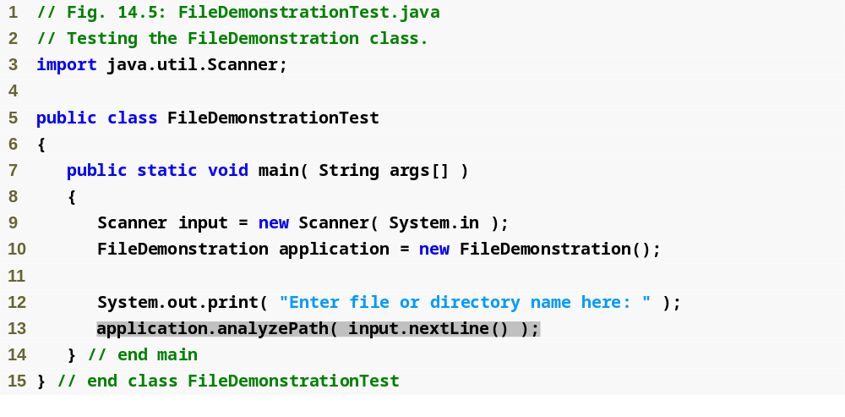
Outline
FileDemonstration
Test.java
(1 of 3)

Slide 23
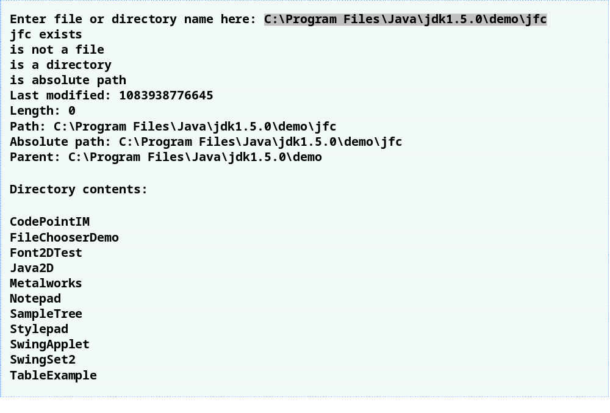
Outline
FileDemonstration
Test.java
(2 of 3)

Slide 24
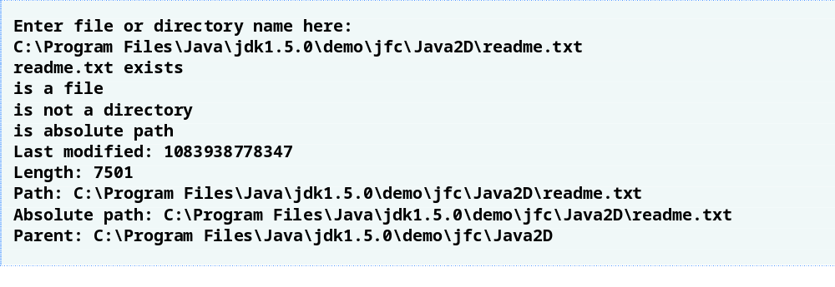
Outline
FileDemonstration
Test.java
(3 of 3)

Slide 25
Common Programming Error 14.1
Using \ as a directory separator rather than \\ in a string literal is a logic error. A single \ indicates that the \ followed by the next character represents an escape sequence. Use \\ to insert a \ in a string literal.

Slide 26
14.5 Sequential-Access Text Files
Records are stored in order by record-key field
Can be created as text files or binary files

Slide 27
Previous Day

Slide 28
14.5.1 Creating a Sequential-Access Text File
Java imposes no structure on a file, records do not exist as part of the Java language
Programmer must structure files
Formatter class can be used to open a text file for writing
  Pass name of file to constructor
  If file does not exist, will be created
  If file already exists, contents are truncated (discarded)
  Use method format to write formatted text to file
  Use method close to close the Formatter object (if method not called, OS normally closes file when program exits)

Slide 29
14.5.1 Creating a Sequential-Access Text File
Possible exceptions
  SecurityException – occurs when opening file using Formatter object, if user does not have permission to write data to file
  FileNotFoundException – occurs when opening file using Formatter object, if file cannot be found and new file cannot be created
  NoSuchElementException – occurs when invalid input is read in by a Scanner object
  FormatterClosedException – occurs when an attempt is made to write to a file using an already closed Formatter object

Slide 30
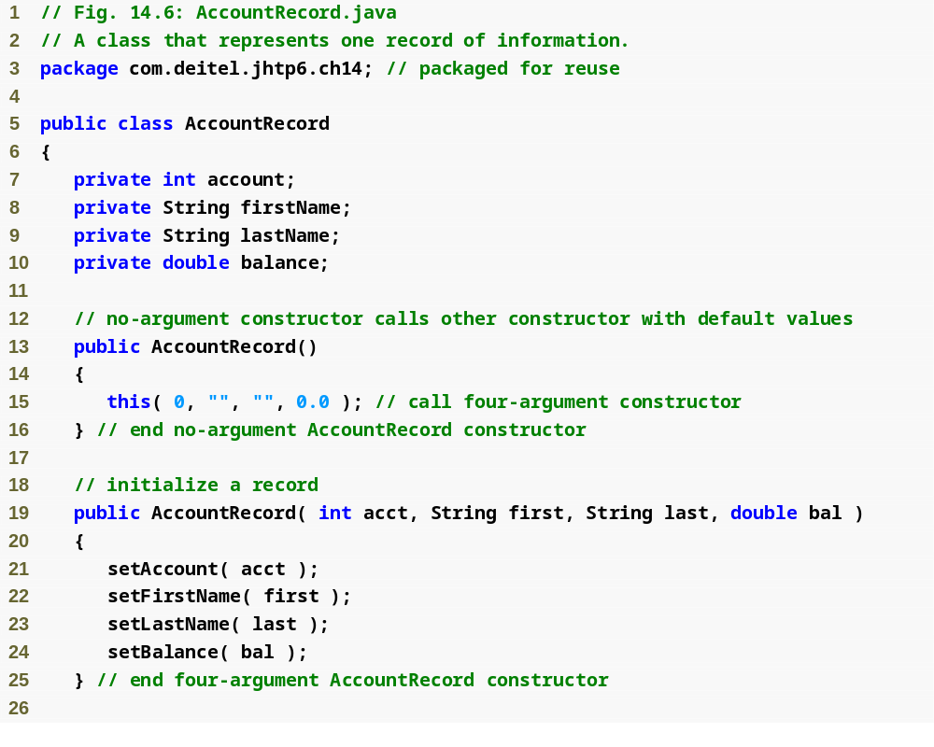
Outline
AccountRecord.java
(1 of 3)

Slide 31
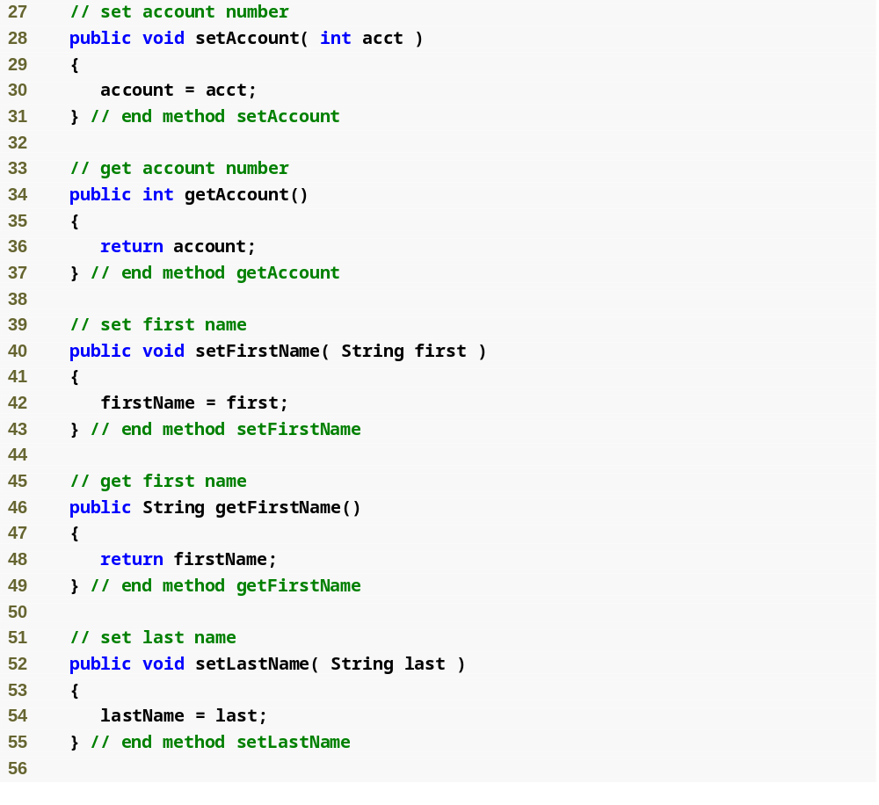
Outline
AccountRecord.java
(2 of 3)

Slide 32
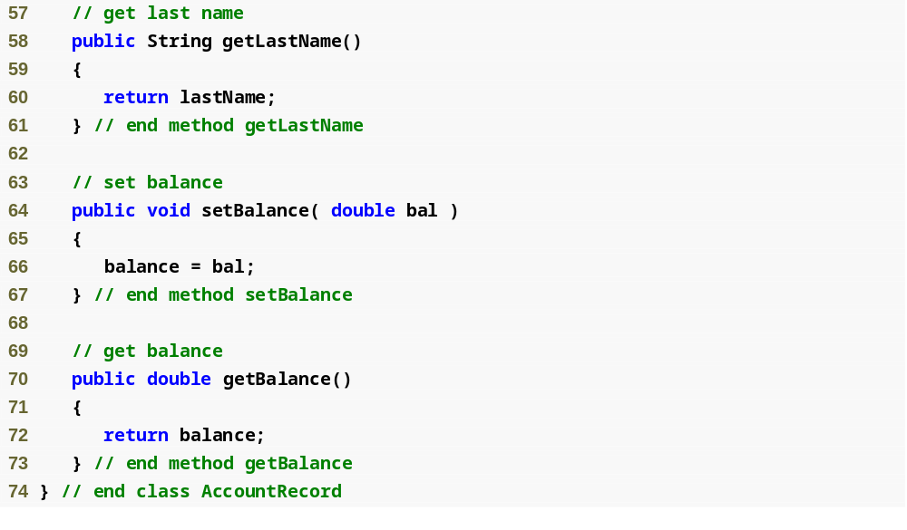
Outline
AccountRecord.java
(3 of 3)

Slide 33
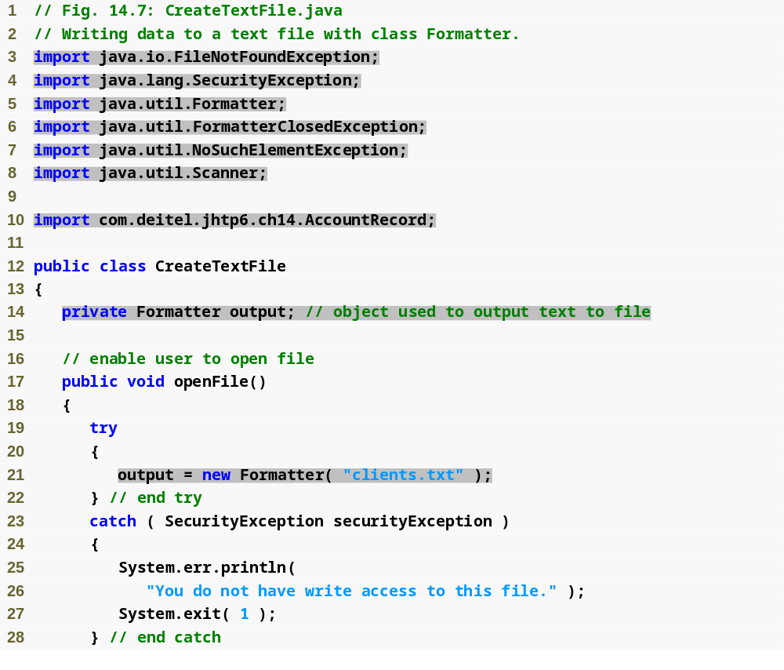
Outline
Used for writing data to file
CreateTextFile
.java
(1 of 4)
Used for retrieving input from user
Object used to output data to file
Open file clients.txt for writing

Slide 34
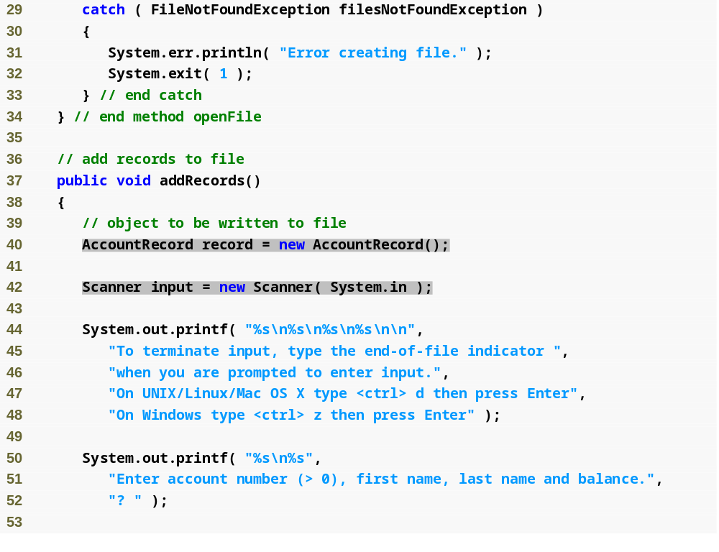
Outline
CreateTextFile
.java
(2 of 4)
Create AccountRecord to be filled with user input
Create Scanner to retrieve input from user

Slide 35
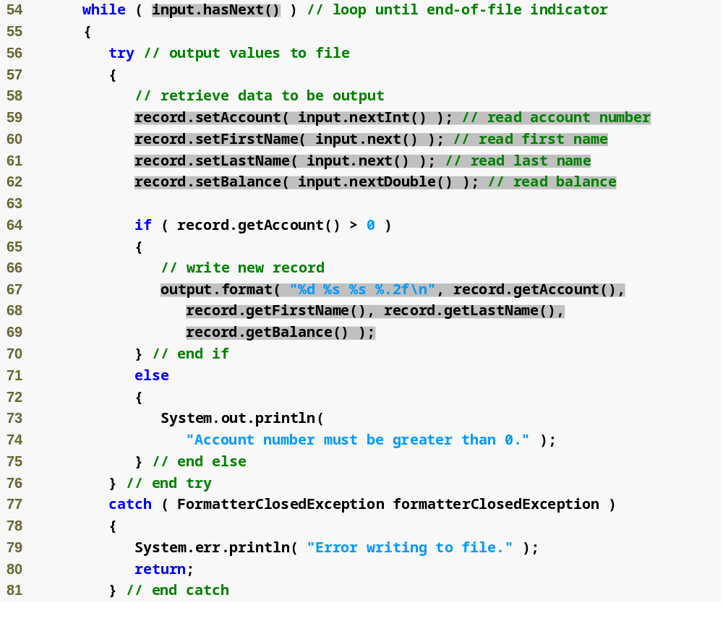
Outline
Loop while user is entering input
CreateTextFile
.java
(3 of 4)
Retrieve input, store data in AccountRecord
Write AccountRecord information to file
File closed while trying to write to it

Slide 36
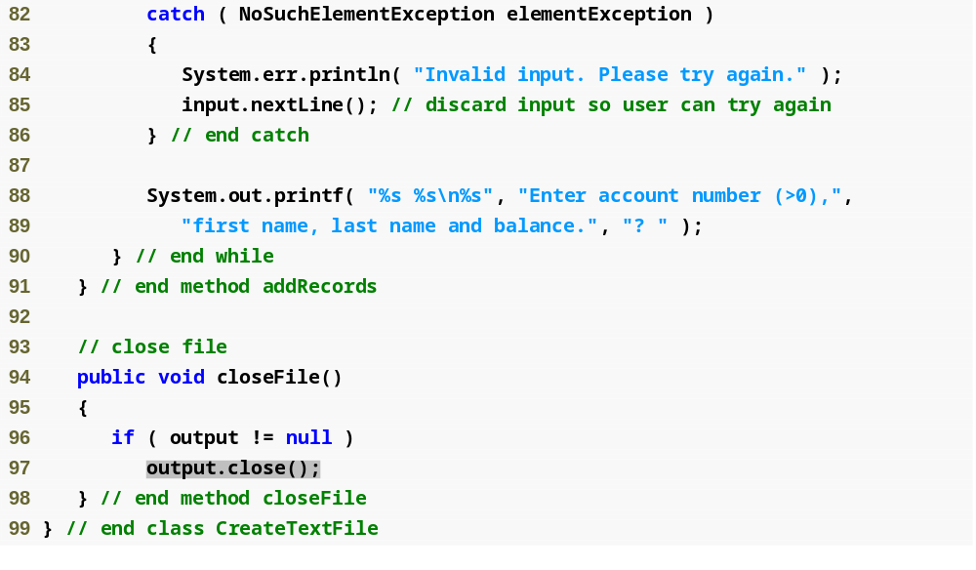
Outline
Error with input entered by user
CreateTextFile
.java
(4 of 4)
Close file

Slide 37
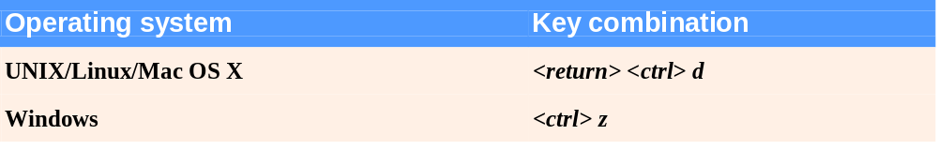
Fig.14.8 | End-of-file key combinations for various popular operating systems.

Slide 38
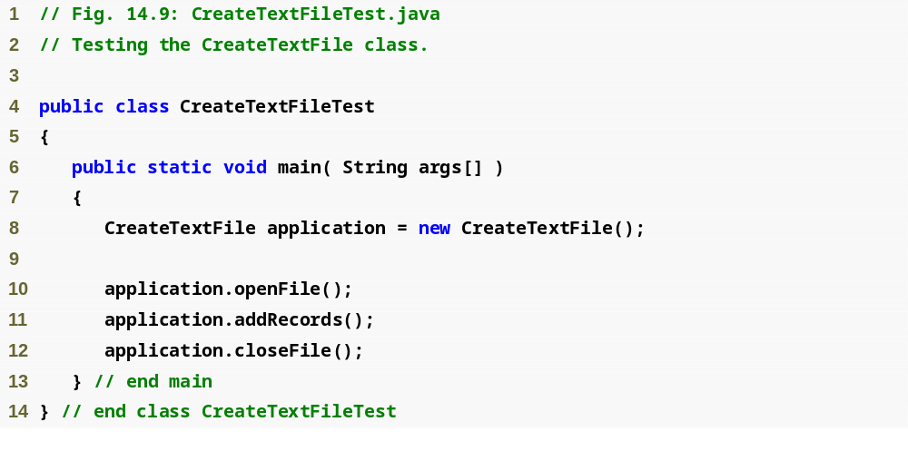
Outline
CreateTextFileTest
.java
(1 of 2)

Slide 39
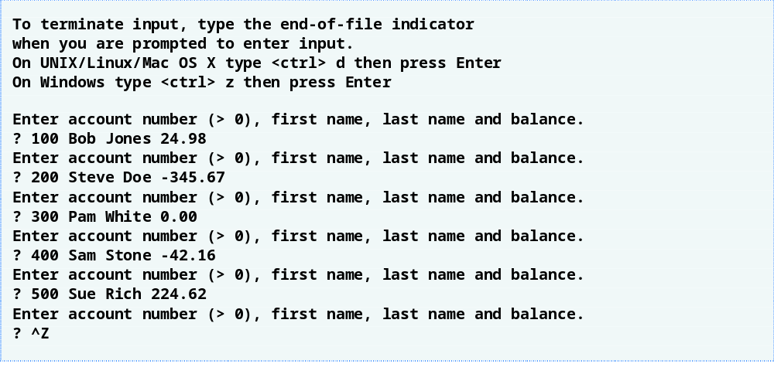
Outline
CreateTextFileTest
.java
(2 of 2)

Slide 40
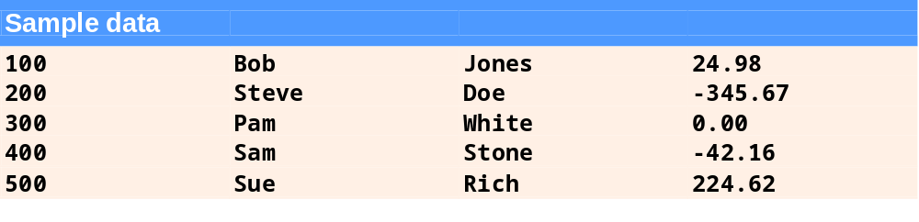
Fig.14.10 | Sample data for the program in Fig. 14.7.

Slide 41
14.5.2 Reading Data from a Sequential-Access Text File
Data is stored in files so that it may be retrieved for processing when needed
Scanner object can be used to read data sequentially from a text file
  Pass File object representing file to be read to Scanner constructor
  FileNotFoundException occurs if file cannot be found
  Data read from file using same methods as for keyboard input – nextInt, nextDouble, next, etc.
  IllegalStateException occurs if attempt is made to read from closed Scanner object

Slide 42
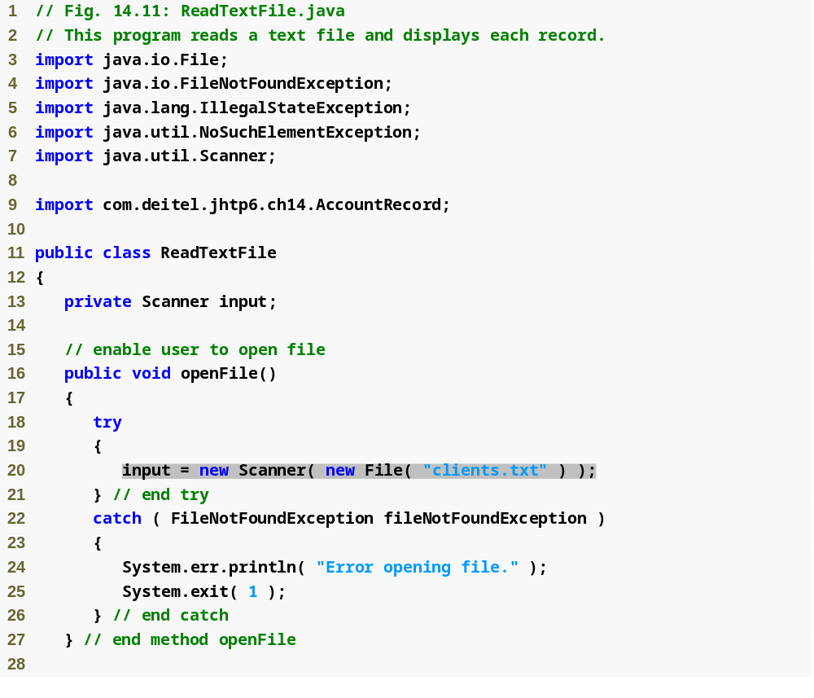
Outline
ReadTextFile.java
(1 of 3)
Open file clients.txt for reading

Slide 43
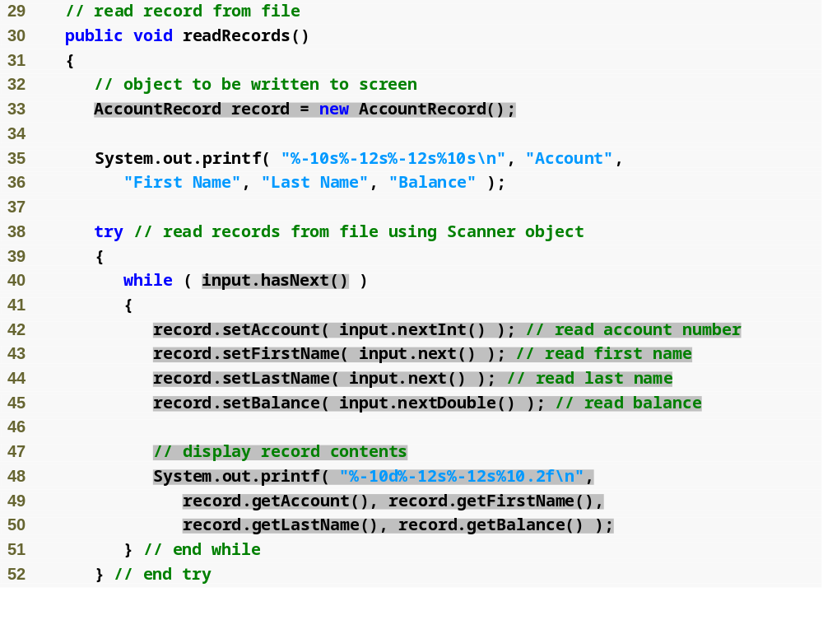
Outline
ReadTextFile.java
(2 of 3)
Create AccountRecord to store input from file
While there is data to be read from file
Read data from file, store in AccountRecord
Display AccountRecord contents

Slide 44
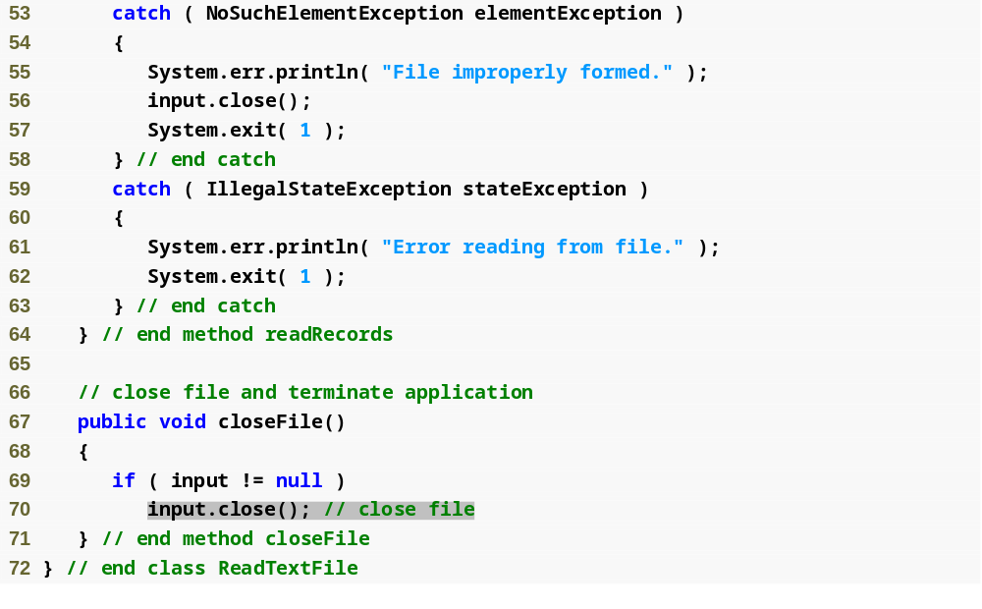
Outline
ReadTextFile.java
(3 of 3)
Close file

Slide 45
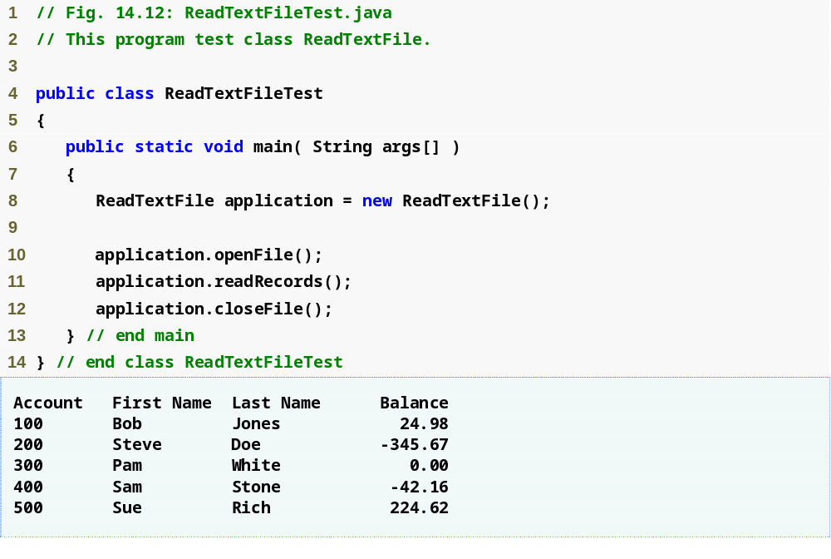
Outline
ReadTextFileTest
.java

Slide 46
14.5.3 Case Study: A Credit-Inquiry Program
To retrieve data sequentially from a file, programs normally start reading from beginning of the file and read all the data consecutively until desired information is found
Class Scanner provides no way to reposition to beginning of file
Instead, file is closed and reopened

Slide 47
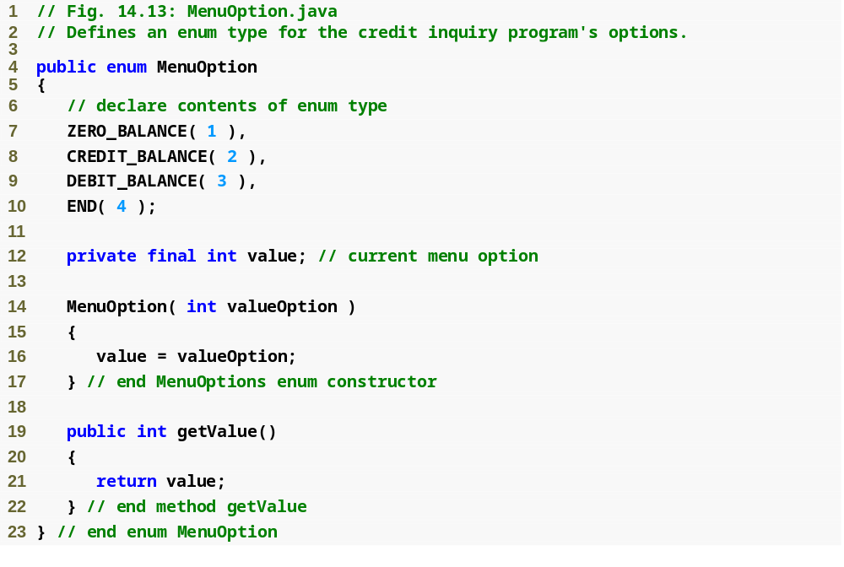
Outline
MenuOption.java

Slide 48
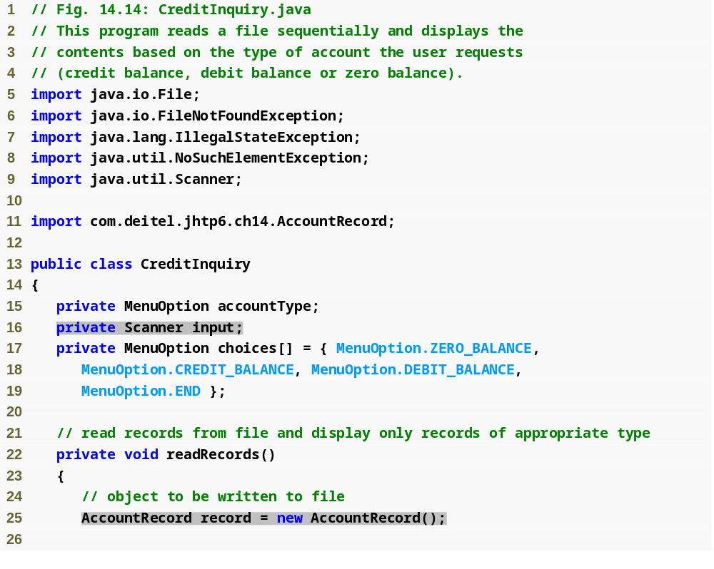
Outline
CreditInquiry.java
(1 of 6)
Scanner used to read data from file
AccountRecord stores record being read from file

Slide 49
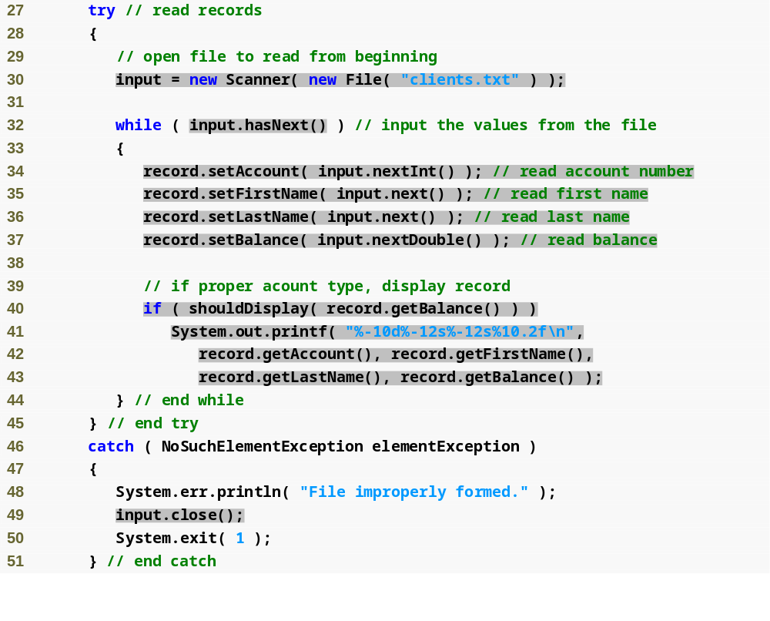
Outline
Open file clients.txt for reading
While there is data to read from file
CreditInquiry.java
(2 of 6)
Check if record is of requested type
Retrieve input, store data in AccountRecord
Display record data to screen
Close Scanner

Slide 50
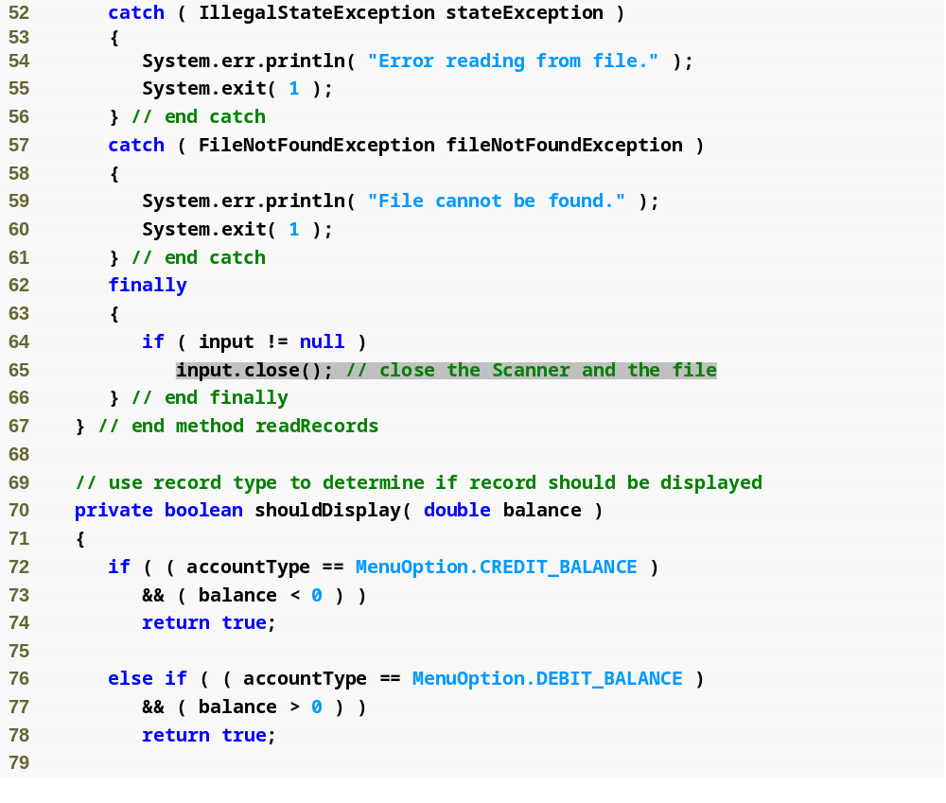
Outline
CreditInquiry.java
(3 of 6)
Close file
Method determines if record is of proper type

Slide 51
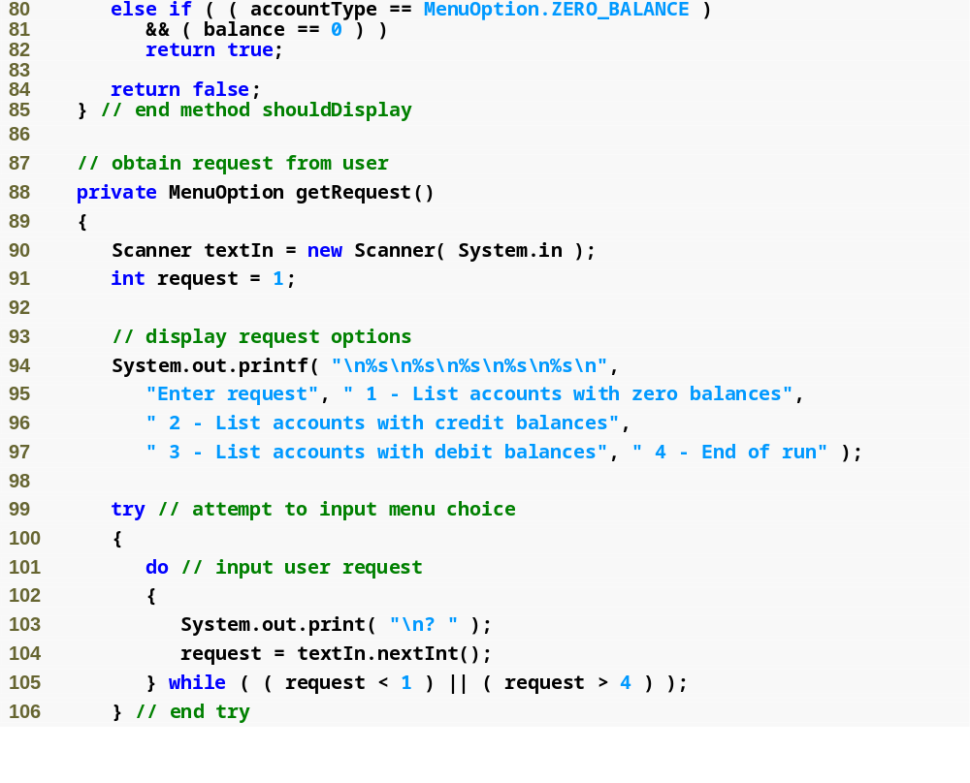
Outline
CreditInquiry.java
(4 of 6)
Loop until user enters valid request
Retrieve request entered

Slide 52
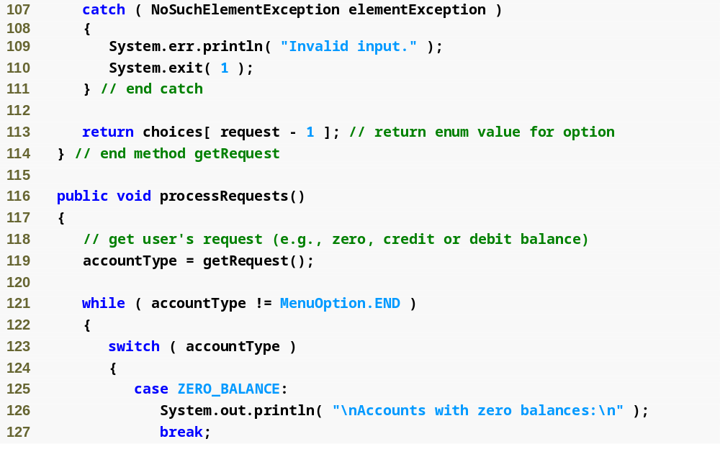
Outline
CreditInquiry.java
(5 of 6)

Slide 53
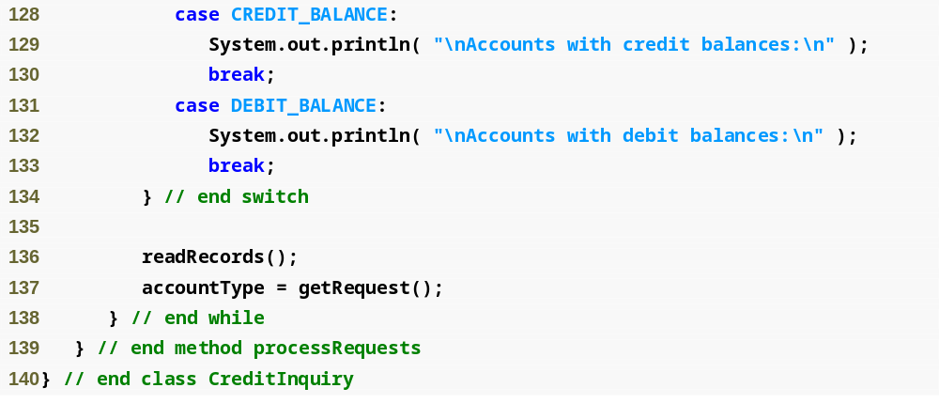
Outline
CreditInquiry.java
(6 of 6)
Read file, display proper records

Slide 54
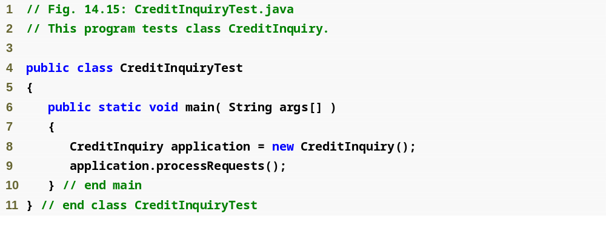
Outline
CreditInquiryTest
.java

Slide 55
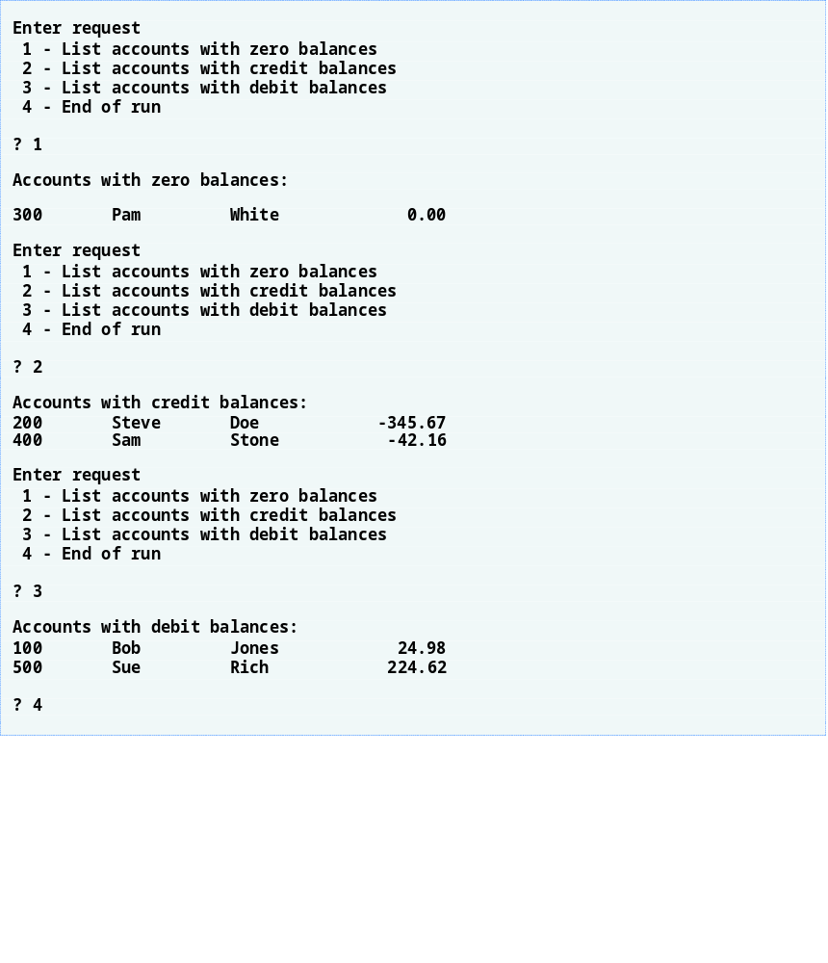
Outline

Slide 56
14.5.4 Updating Sequential-Access Files
Data in many sequential files cannot be modified without risk of destroying other data in file
Old data cannot be overwritten if new data is not same size
Records in sequential-access files are not usually updated in place. Instead, entire file is usually rewritten.

Slide 57
14.6 Object Serialization
With text files, data type information lost
Object serialization – mechanism to read or write an entire object from a file
Serialized object – object represented as sequence of bytes, includes object’s data and type information about object
Deserialization – recreate object in memory from data in file
Serialization and deserialization performed with classes ObjectInputStream and ObjectOutputStream, methods readObject and writeObject

Slide 58
14.6.1 Creating a Sequential-Access File Using Object Serialization:
Defining the AccountRecordSerializable Class
Serializable interface – programmers must declare a class to implement the Serializable interface, or objects of that class cannot be written to a file
To open a file for writing objects, create a FileOutputStream wrapped by an ObjectOutputStream
  FileOutputStream provides methods for writing byte-based output to a file
  ObjectOutputStream uses FileOutputStream to write objects to file
  ObjectOutputStream method writeObject writes object to output file
  ObjectOutputStream method close closes both objects

Slide 59
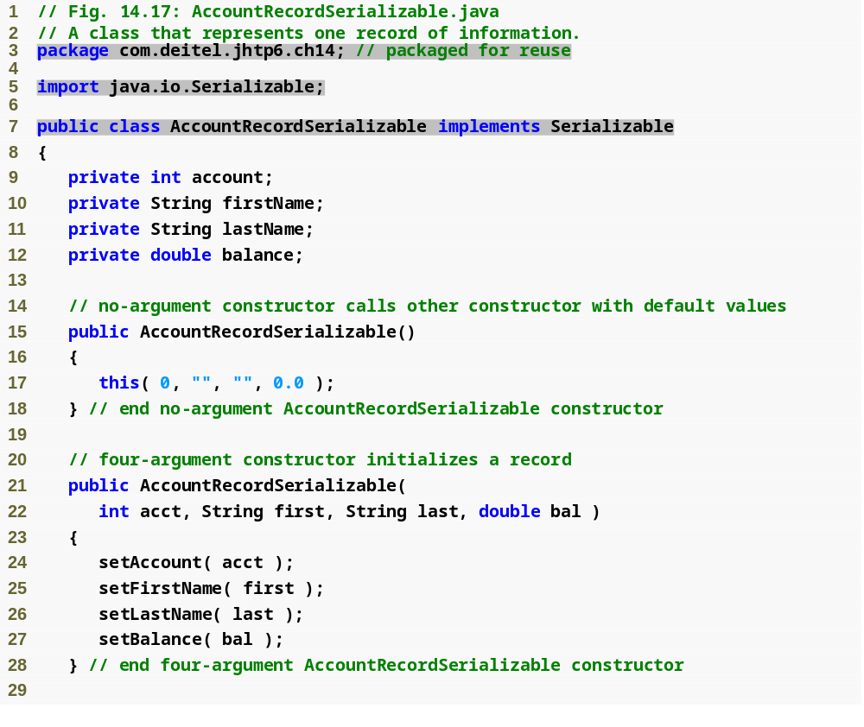
Outline
AccountRecord
Serializable.java
(1 of 3)
Interface Serializable specifies that AccountRecordSerializable objects can be written to file

Slide 60
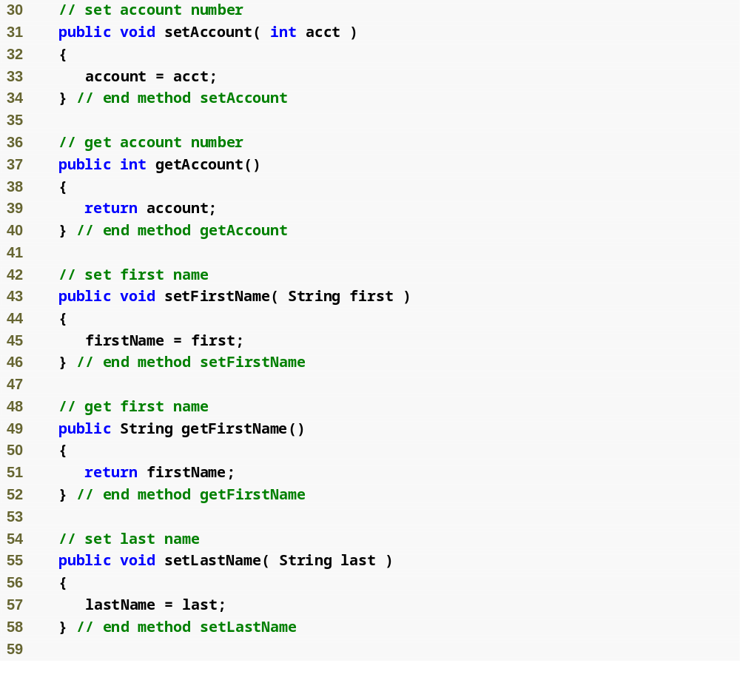
Outline
AccountRecord
Serializable.java
(2 of 3)

Slide 61
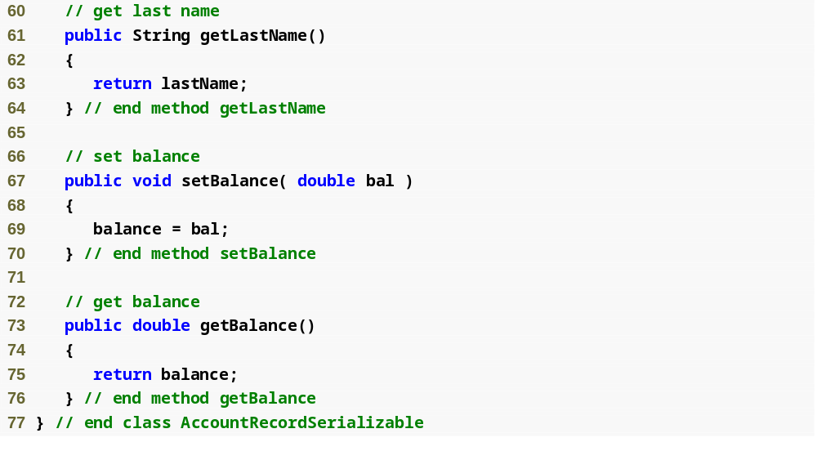
Outline
AccountRecord
Serializable.java
(3 of 3)

Slide 62
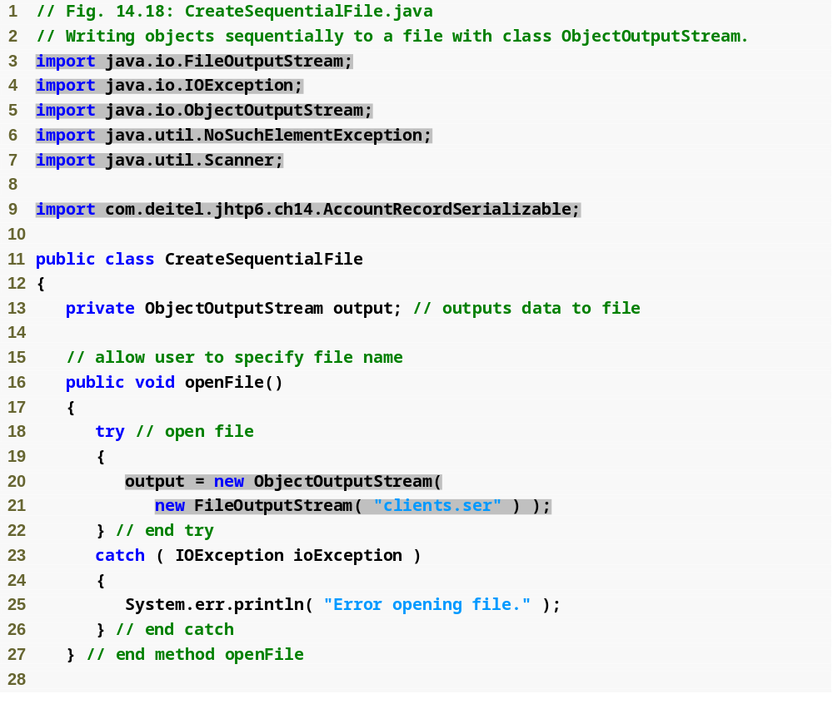
Outline
Class used to create byte-based output stream
Class used to create output object data to byte-based stream
CreateSequential
File.java
(1 of 4)
Open file clients.ser for writing

Slide 63
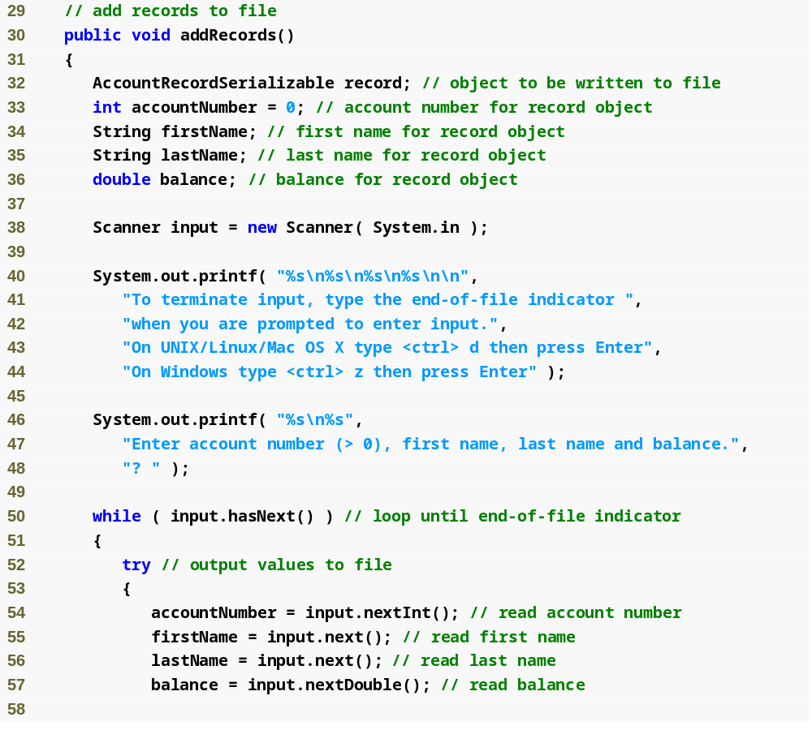
Outline
CreateSequential
File.java
(2 of 4)

Slide 64
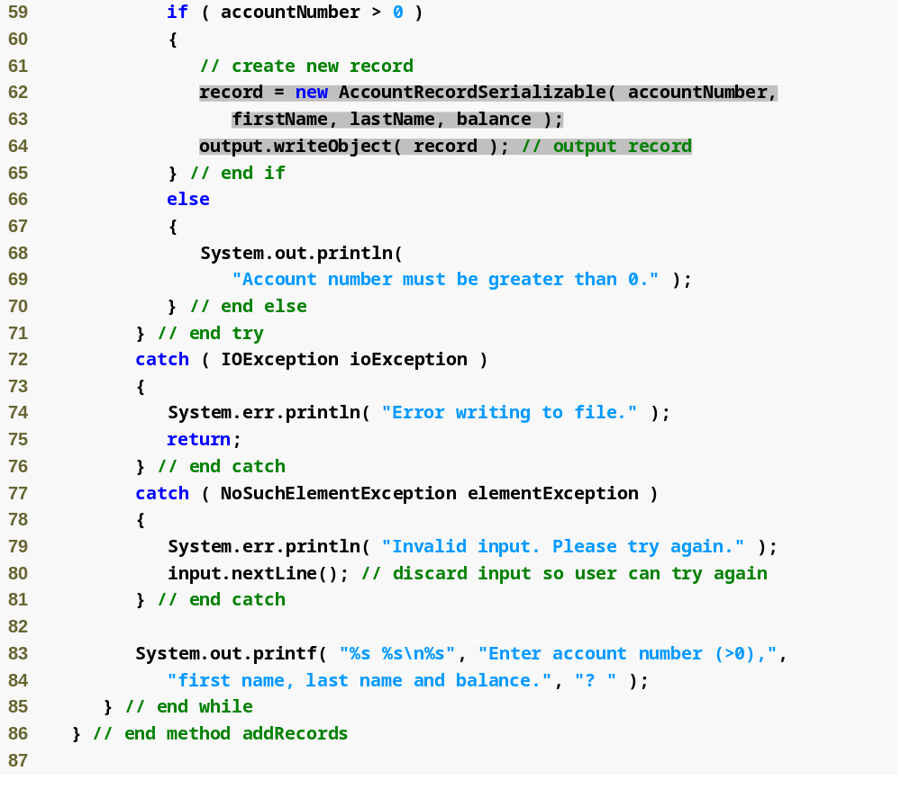
Outline
Write record object to file
Create AccountRecord based on user input
CreateSequential
File.java
(3 of 4)

Slide 65
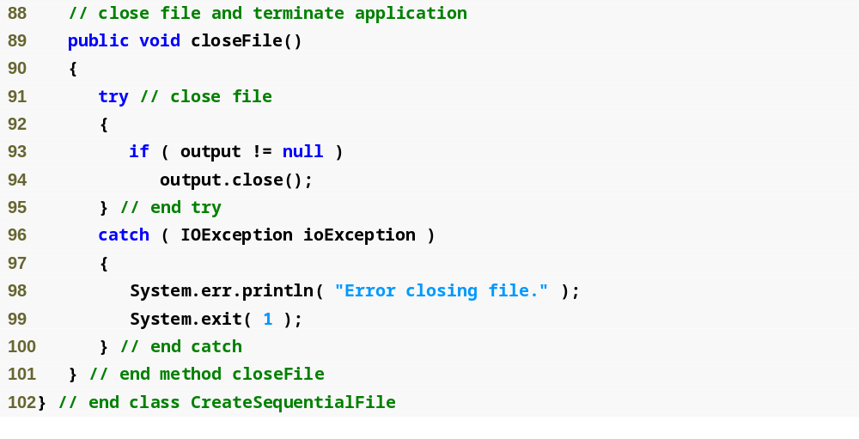
Outline
CreateSequential
File.java
(4 of 4)

Slide 66
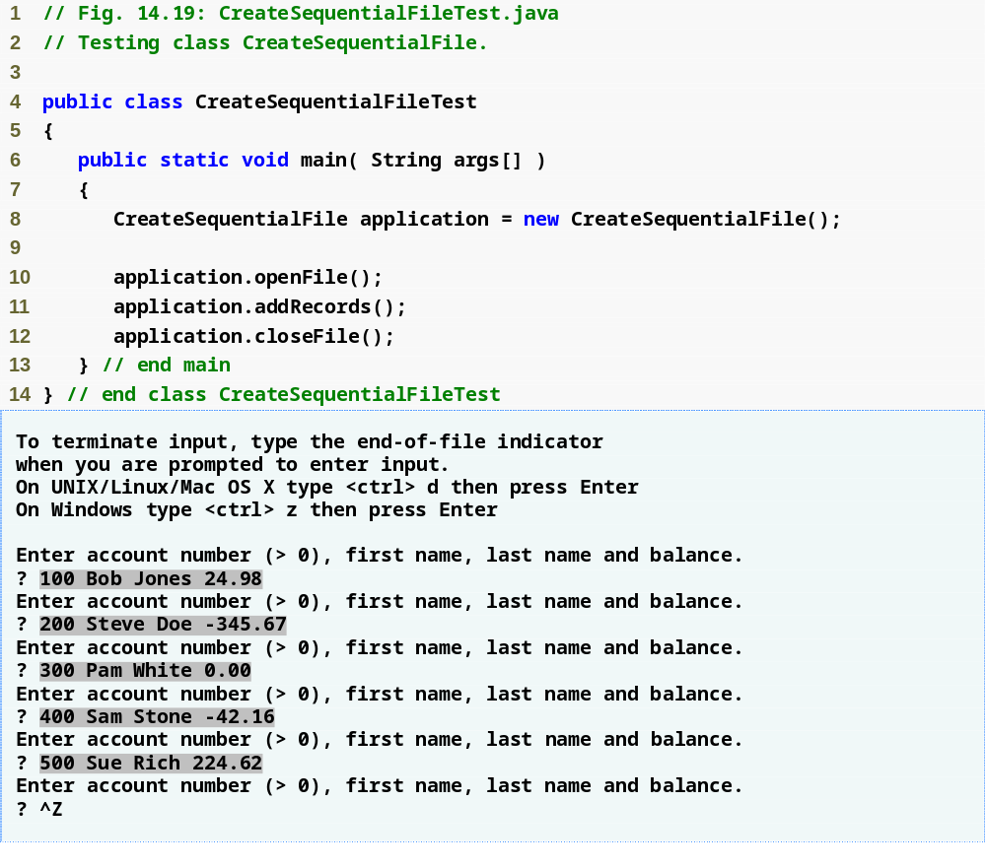
Outline
CreateSequential
FileTest.java

Slide 67
Common Programming Error 14.2
It is a logic error to open an existing file for output when, in fact, the user wishes to preserve the file.

Slide 68
14.6.2 Reading and Deserializing Data from a Sequential-Access File
To open a file for reading objects, create a FileInputStream wrapped by an ObjectInputStream
  FileInputStream provides methods for reading byte-based input from a file
  ObjectInputStream uses FileInputStream to read objects from file
  ObjectInputStream method readObject reads in object, which is then downcast to proper type
    EOFException occurs if attempt made to read past end of file
    ClassNotFoundException occurs if the class for the object being read cannot be located
  ObjectInputStream method close closes both objects

Slide 69
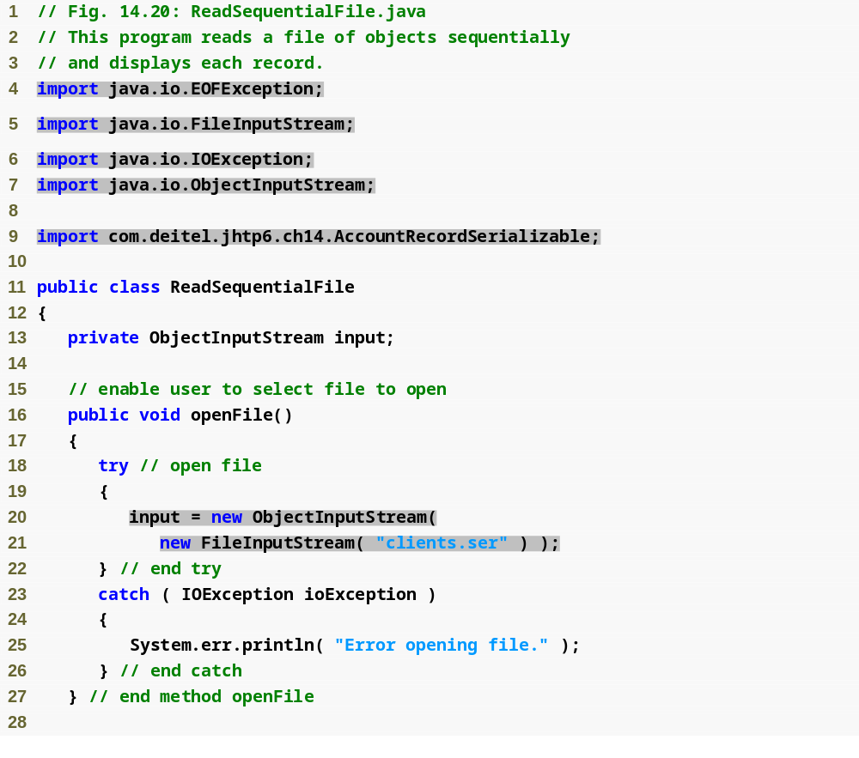
Outline
Class used to create byte-based input stream
ReadSequentialFile.java
(1 of 3)
Class used to read input object data to byte-based stream
Open file clients.ser for reading

Slide 70
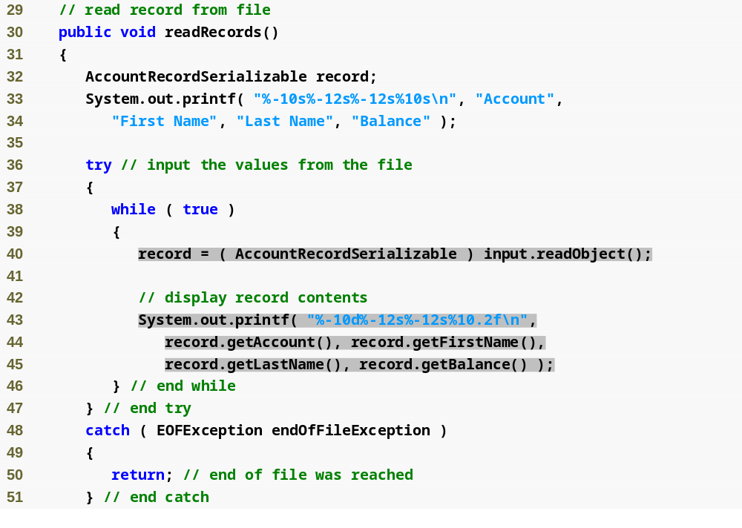
Outline
ReadSequentialFile.java
(2 of 3)
Read record from file
Output record information to screen

Slide 71
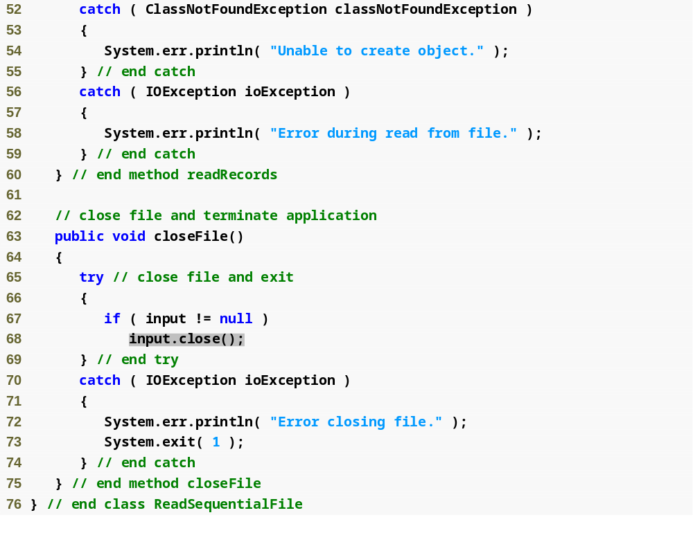
Outline
ReadSequentialFile.java
(3 of 3)
Close file

Slide 72
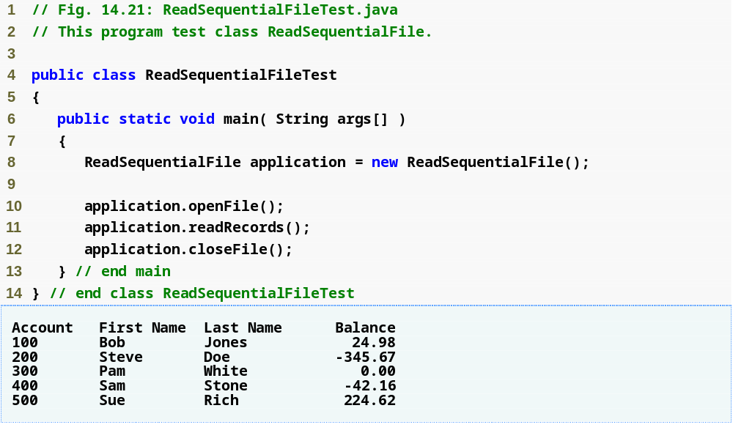
Outline
ReadSequentialFileTest.java

Slide 73
14.7 Random-Access Files
Sequential-access files inappropriate for instant-access applications
Instant-access applications are applications in which desired information must be located immediately
Instant access possible with random-access files (also called direct-access files) and databases
Data can be inserted in random-access file without destroying other data
Different techniques for creating random-access files
  Simplest: Require that all records in file be same fixed length
    Easy to calculate (as a function of record size and record key) exact location of any record relative to beginning of file

Slide 74
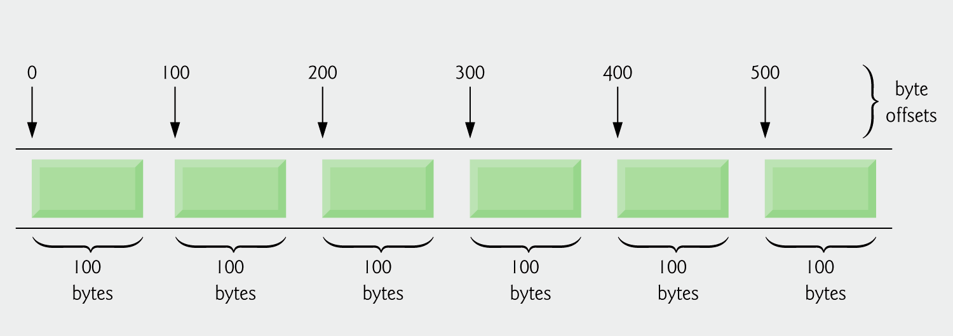
Fig. 14.22 | Java’s view of a random-access file.

Slide 75
14.7.1 Creating a Random-Access File
RandomAccessFile class
  Includes all capabilities of FileInputStream and FileOutputStream
  Includes capabilities for reading and writing primitive-type values, byte arrays and strings
  Using RandomAccessFile, program can read or write data beginning at location specified by file-position pointer
  Manipulates all data as primitive types
  Methods readInt, readDouble, readChar used to read integer, double and character data from file
  Methods writeInt, writeDouble, writeChars used to write integer, double and string data to file
  File-open mode – specifies whether file is opened for reading (“r”), or for both reading and writing (“rw”). File-open mode specified as second argument to RandomAccessFile constructor

Slide 76
14.7.1 Creating a Random-Access File
StringBuffer class – allows us to dynamically manipulate strings
  String objects are immutable, StringBuffer used so strings can be changed dynamically
  Can store a number of characters specified by capacity
  If the capacity is exceeded, the capacity is expanded
  Number of characters in StringBuffer set with method setLength
Create random access file by writing blank or empty records to file for amount of records that will be needed

Slide 77
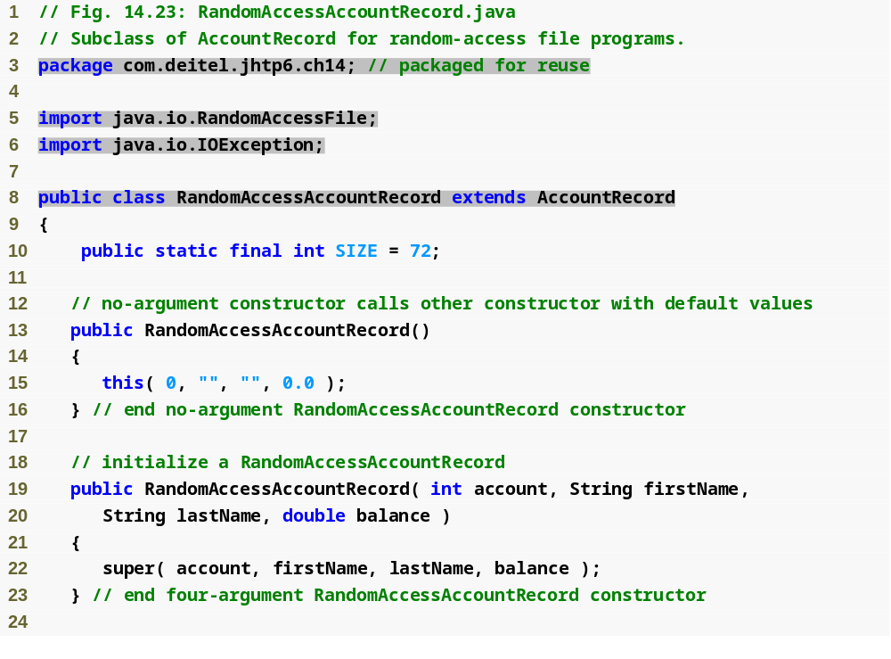
Outline
Used to write to and read from random-access files
RandomAccess
AccountRecord.java
(1 of 3)

Slide 78
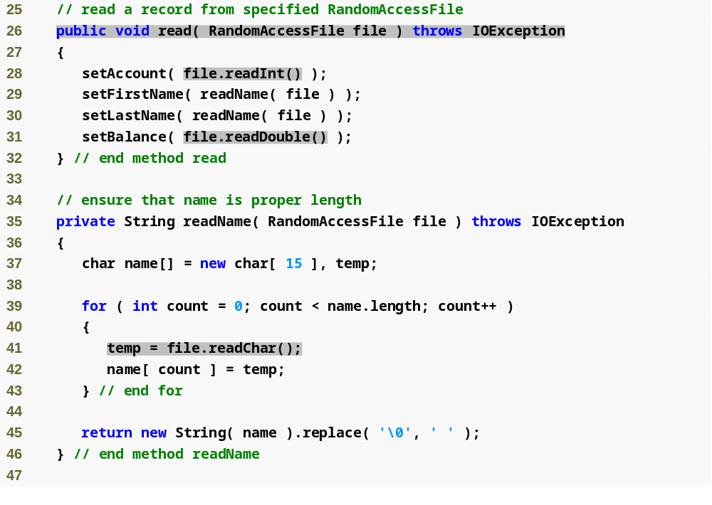
Outline
Method reads primitive-type data, stores in RandomAccessAccountRecord object
RandomAccess
AccountRecord.java
(2 of 3)
Read characters, aggregate into string

Slide 79
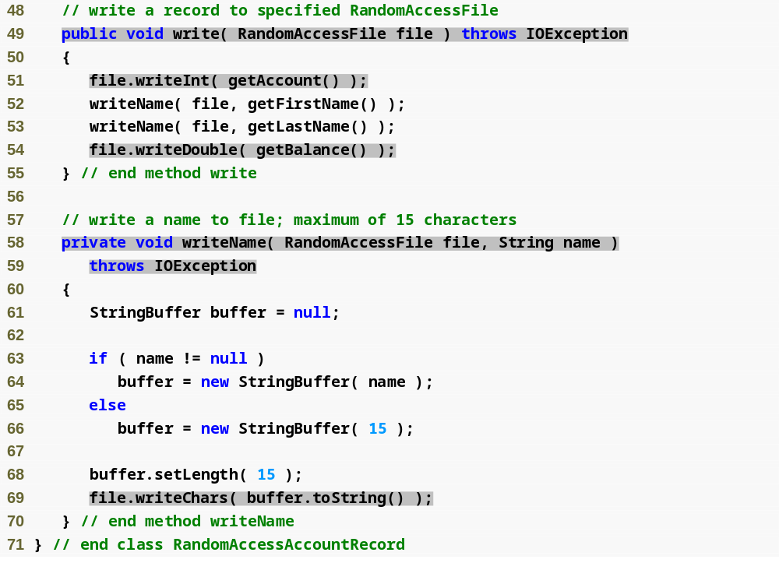
Outline
Method writes primitive-type data based on data from RandomAccessAccountRecord object
RandomAccess
AccountRecord.java
(3 of 3)
Writes first and last names to file, make sure each has 15 characters

Slide 80
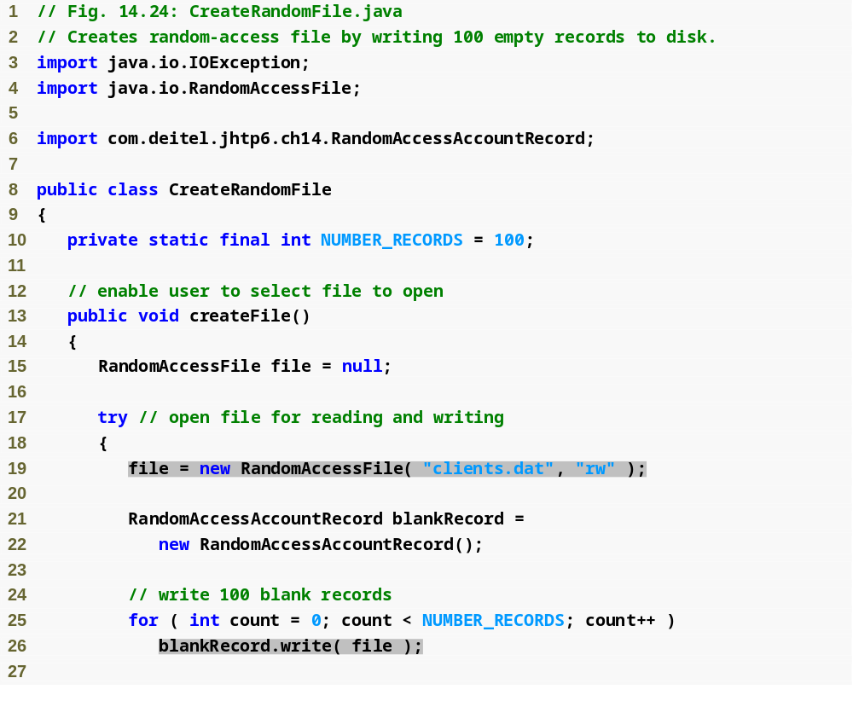
Outline
CreateRandomFile
.java
(1 of 2)
Open file for reading and writing
Create a blank record
Output blank record 100 times, for each possible account

Slide 81
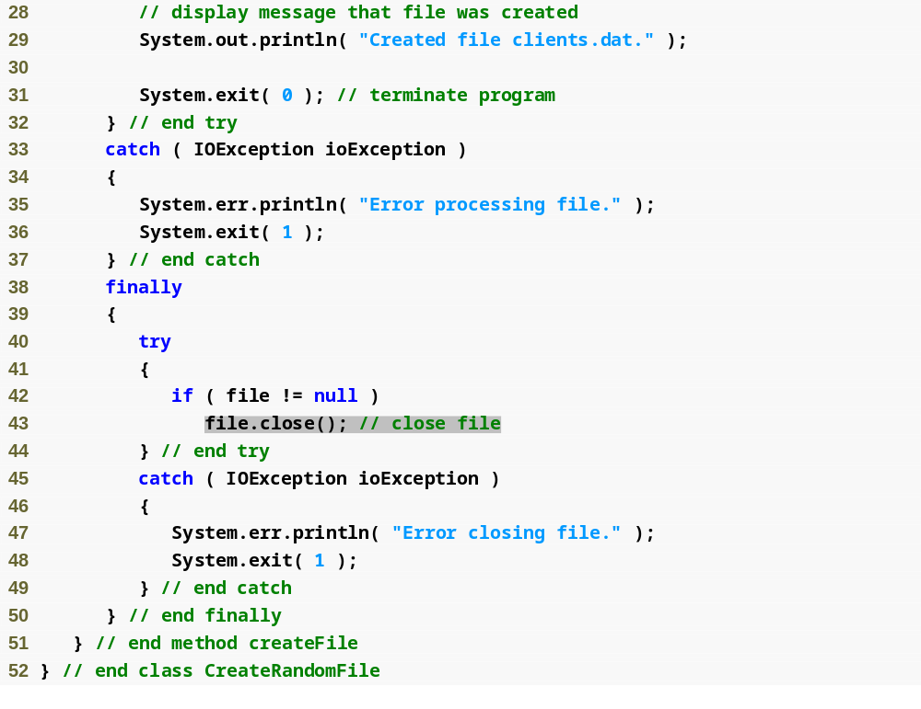
Outline
CreateRandomFile
.java
(2 of 2)
Close file

Slide 82

Outline
CreateRandomFile
Test.java

Slide 83
14.7.2 Writing Data Randomly to a Random-Access File
RandomAccessFile method seek positions file-position pointer to a specific location in a file relative to beginning of file
Size of each record is known, so location in file of a specific record can be found by multiplying size of record with number of record
Once location known, new record data can be written without worrying about rest of file, as each record is always same size

Slide 84

Outline
WriteRandomFile
.java
(1 of 4)
Open file for reading and writing

Slide 85

Outline
WriteRandomFile
.java
(2 of 4)

Slide 86

Outline
WriteRandomFile
.java
(3 of 4)
Store input data in RandomAccessAccountRecord

Slide 87

Outline
Calculate location of new record
Output new record to file
WriteRandomFile
.java
(4 of 4)

Slide 88

Outline
WriteRandomFile
Test.java

Slide 89
14.7.3 Reading Data Sequentially from a Random-Access File
Open file with “r” file-open mode for reading
Ignore empty records (usually those with account number of zero) when reading from file
Records stored by account number in random-access files have added bonus of being sorted, as each record’s data can only be placed in specific portion of file
Sorting with direct-access techniques is blazingly fast—speed achieved by making file large enough to hold every possible record
  Space/time trade-off

Slide 90
Good Programming Practice 14.1
Open a file with the “r” file-open mode for input if the contents should not be modi­fied. This practice prevents unintentional modification of the file’s contents. This is another example of the principle of least privilege.

Slide 91

Outline
ReadRandomFile
.java
(1 of 3)
Open file for reading

Slide 92

Outline
ReadRandomFile
.java
(2 of 3)
Read until non-blank record found
Exception occurs when end of file reached

Slide 93

Outline
ReadRandomFile
.java
(3 of 3)

Slide 94

Outline
ReadRandomFileTest
.java

